Slide 1

L-1 Ethics, ENRICHMENT AND impact in Scientific Writing Part II
Research and Publication Ethics
Dr. Divya Singh
Designation- Associate Professor
divya.singh@mygyanvihar.com

Slide 2
Objective
. The students will understand basic concept of publication and ethics

Slide 3

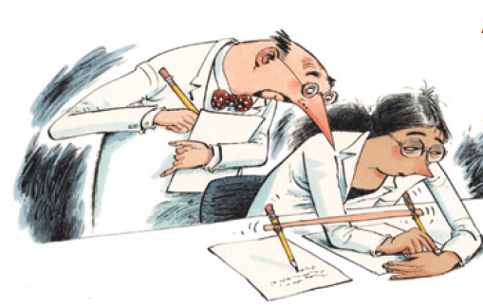
Redundant publication
Special type of plagiarism: duplication of publish material with new/unpublished Data happens when publishing first an extended abstract (e.g. for a conference) and then a full article.
Why redundant publication is a problem:
- copyright
- increased burden for reviewers
- makes scientific communication difficult (un-centralization of results)
it overemphasizes results (and generates problems for meta-analysis studies)

Slide 4
Duplicate publication
Publication of an article that is identical (or almost) to an already published article.
It also classifies as plagiarism
Same problems as redundant publication
Special case: translation of an article in a non-English language
Consequences of duplicate submission:
Rejection of both manuscripts
Editor may contact the authors’ institution
Duplicate publication
May lead to retraction (14.2% of all retractions)
Biases the literature
Wastes editors’ and reviewers’ time.

Slide 5
Conflict of Interest
Any situation that can lead to non-objective conclusions by an author.
These can be due to money/grants/contracts It can also arise when reviewing a close-colleague work.
All possible conflicts of interest should be disclosed:
Example, from Remote Sensing of Environment:
“All authors are requested to disclose any actual or potential conflict of interest including any financial, personal or other relationships with other people or organizations within three years of beginning the submitted work that could inappropriately influence, or be perceived to influence, their work.”

Slide 6
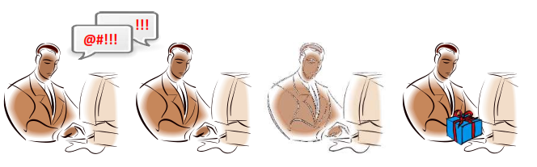
Authorship issues
→ Number of papers very important in scientific career
→ Often difficult to establish who “merits” to be listed as a co-author
The list of authors establishes accountability as well as credit.
Policies at most scientific journals state that a person should be listed as the author of a paper only if that person made a direct and substantial intellectual contribution to the design of the research, the interpretation of the data, or the drafting of the paper.
The acknowledgments section can be used to thank those who indirectly contributed to the work.
It includes “honorary,” “guest,” or “gift” authorship

Slide 7
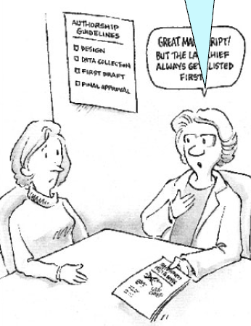
Authorship issues
First author:
Coordinate the completion and submission of a manuscript
Responsible for all communication (sometimes corresponding author is the most senior author)
Coordinator/supervisor often comes last (first and last positions are the most critical)
Ensure recognition for all players (co-authors, acknowledgements...)
Obtain approval from all co-authors
Co-authors should have made an important contribution to a given paper:
- Conception and design of experiments
- Acquisition of data
- Analysis and interpretation of data
- Drafting the article
- Revise the paper (before submission)
- Final approval of the version to be published
Great manuscript! But the lab chief always gets listed as first author

Slide 8
Other issues
Data access and retention:
Authors may be asked to provide the raw data in connection with a paper for editorial review, and should be prepared to provide public access to such data.
Fundamental errors in published works:
When an author discovers a significant error or inaccuracy in his/her own published work, it is the author's obligation to promptly notify the journal editor or publisher and cooperate with the editor to retract or correct the paper. It should be corrected in a note, erratum (for a production error), or Additions/Corrections
Reporting standards:
Authors of reports of original research should present an accurate account of the work performed as well as an objective discussion of its significance.
Hazards and human or animal subjects:
Statements of compliance are required if the work involves chemicals, procedures or equipment that have any unusual hazards inherent in their use, or if it involves the use of animal or human subjects.

Slide 9
Anti-plagiarism Tools
Plagiarism.org (www.plagiarism.org)
Turnitin.com (www.turnitin.com)
Plagiarism Checker (http://www.plagiarismchecker.com/)
Plagiarism Detector (http://www.plagiarism-detector.com)
And many more software…….
Notes:
Any thoughts on this real-life impact of cheating?

Slide 10

Say No to Plagiarism
Notes:
10
Plagiarism is a form of cheating. Copying and writing the ideas of others and presenting them as your own.
Plagiarism is no exception and could be known as theft and should be treated as such.

Slide 11
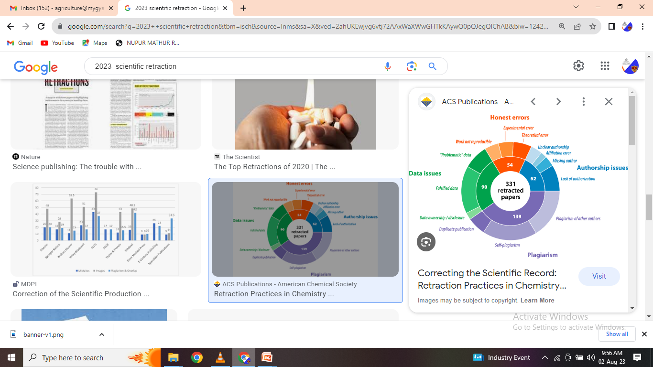

Slide 12
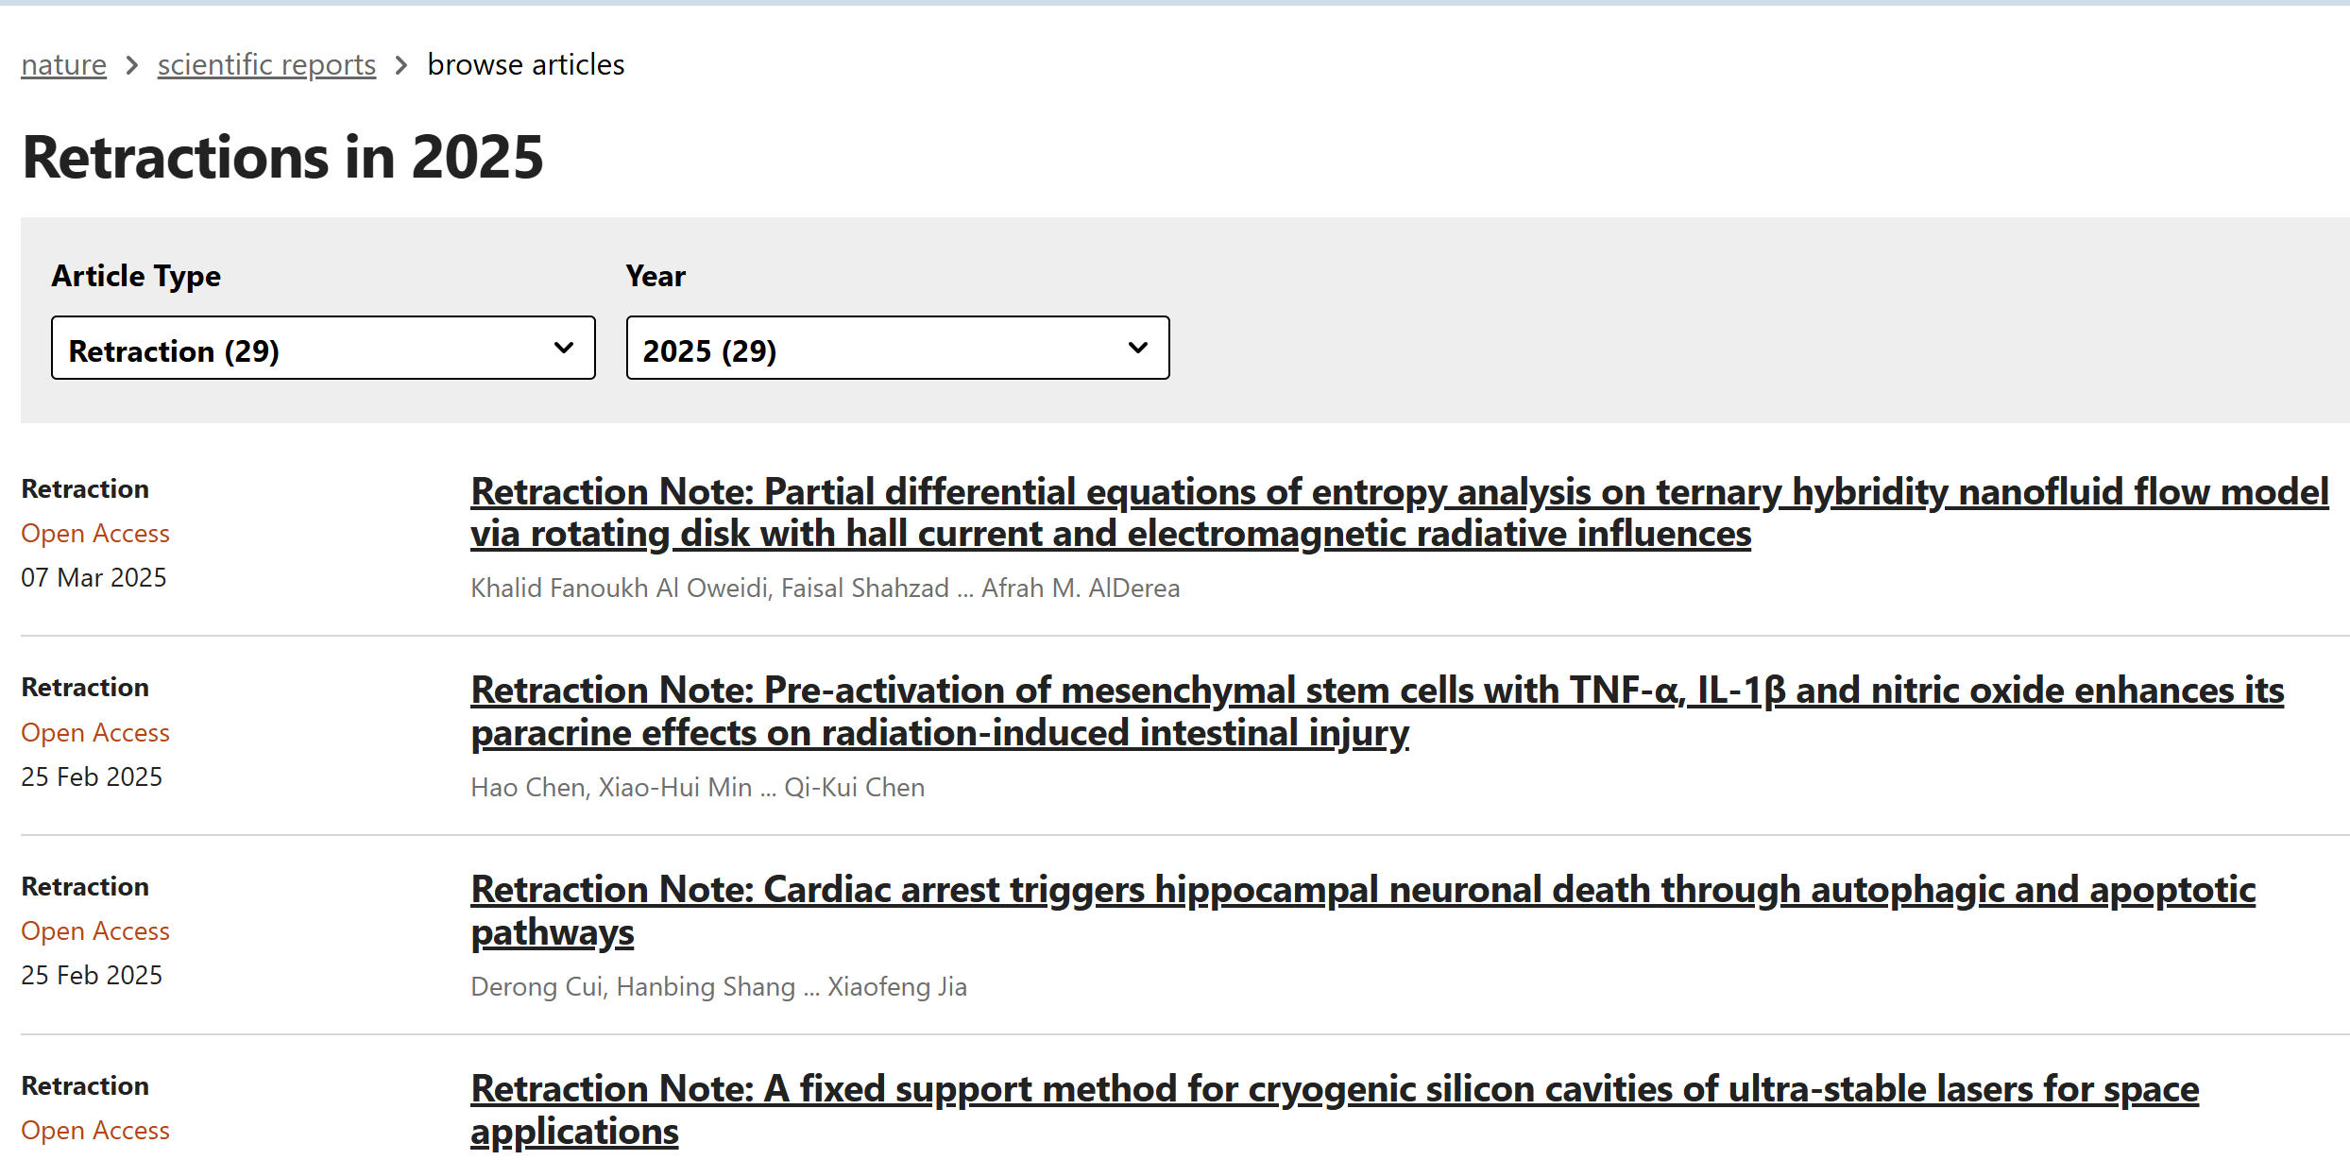

Slide 13
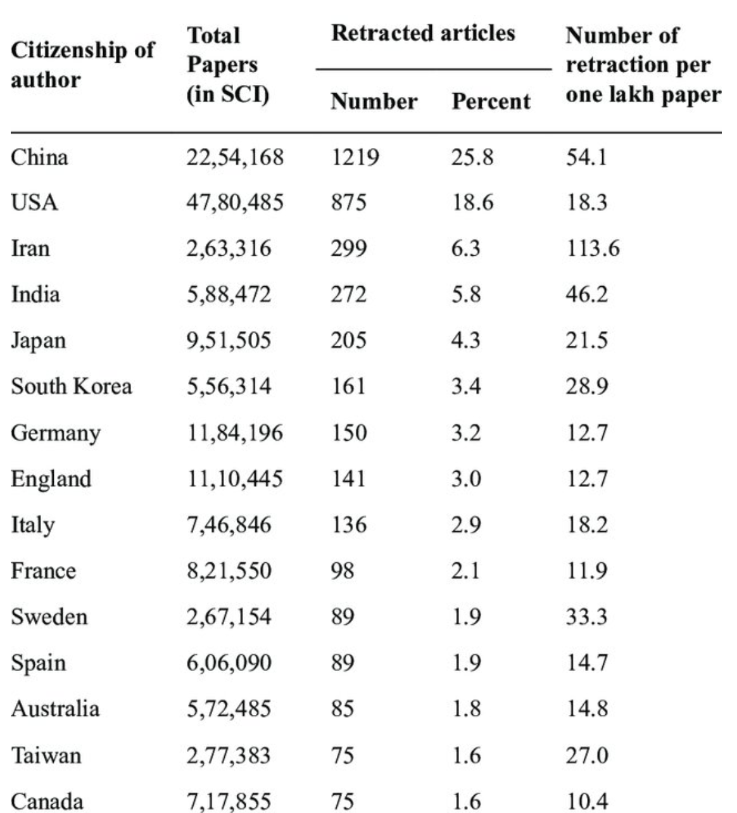
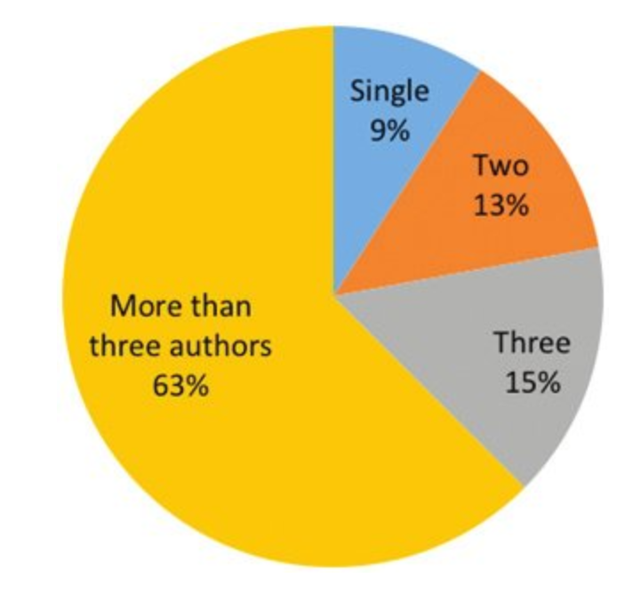

Slide 14
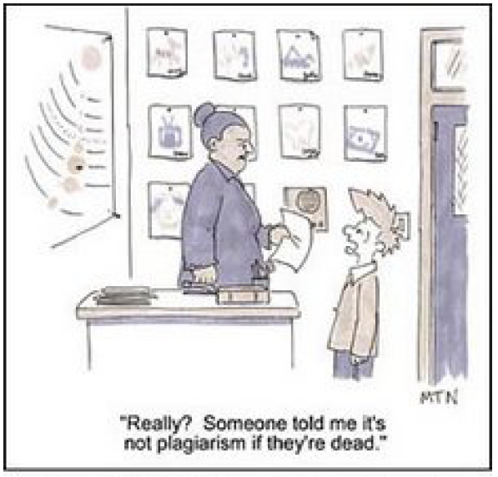

Slide 15
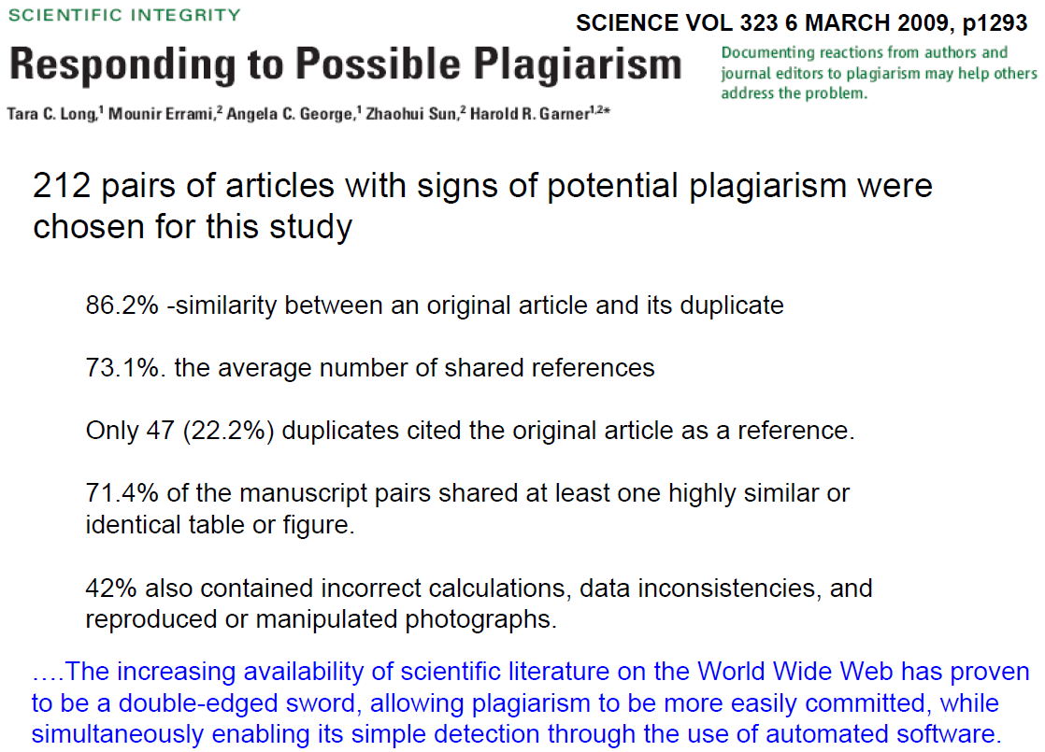

Slide 16
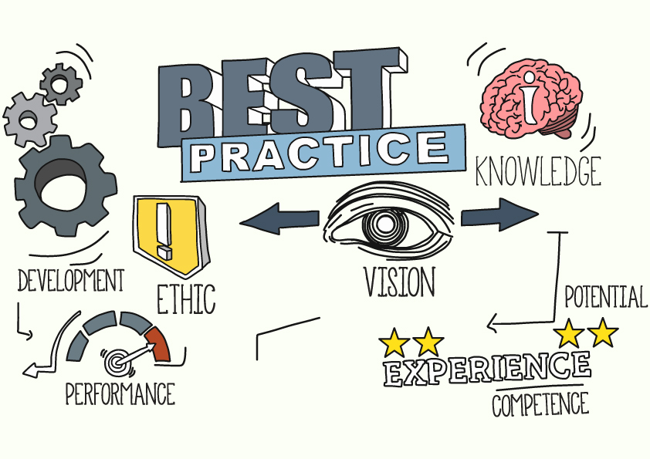
Good Scientific Publication Practice
Avoid misrepresentation in publications
Publish accurate, complete, clear, and unbiased work
Avoid fragmentary publication
Publish manuscripts that represent substantial findings
Avoid duplicate manuscript submission & publication
Publish research

Slide 17
An easy to remember
Scientific moral code
Do not
Lie (fabrications)
Cheat (falsifications)
Steal (plagiarism)

Slide 18
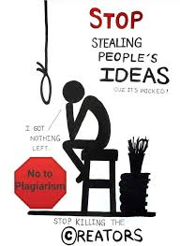
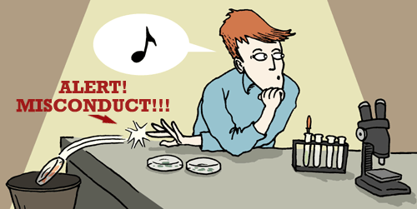
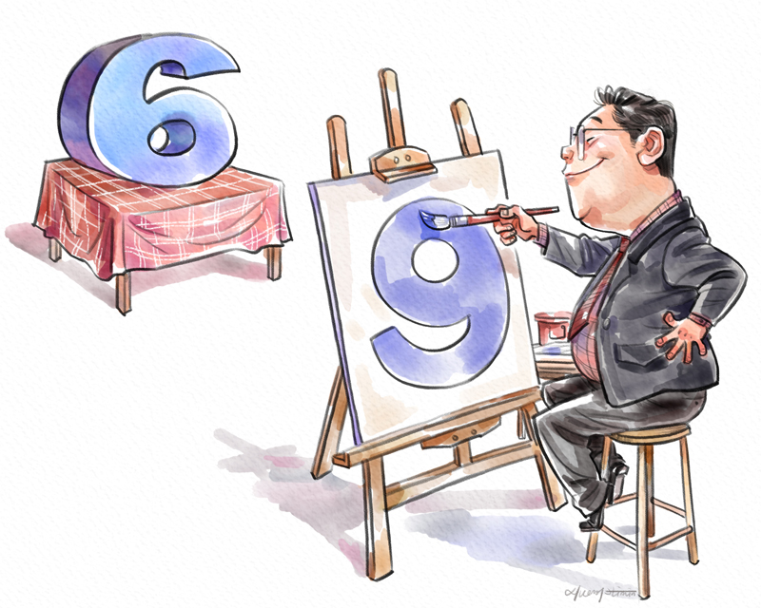
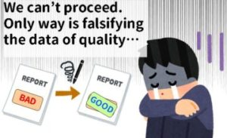

Slide 19
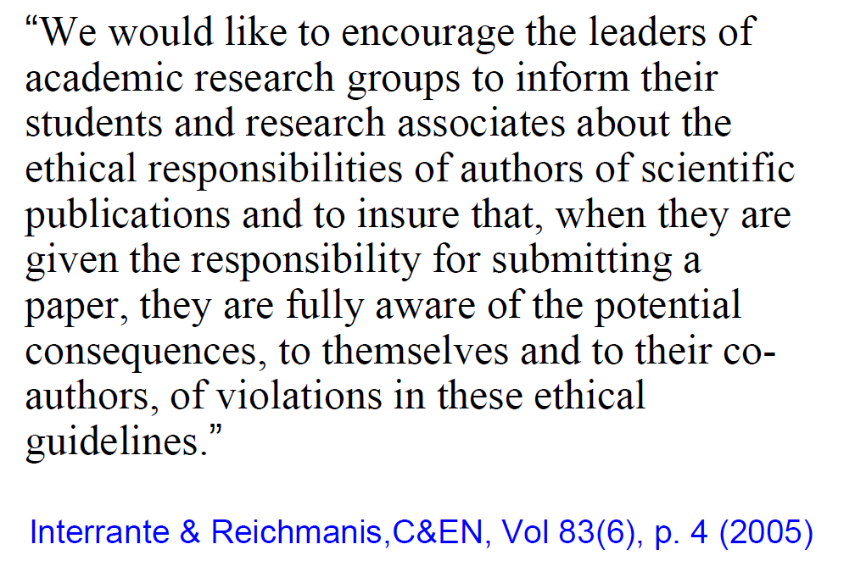
A Call for Cooperation

Slide 20
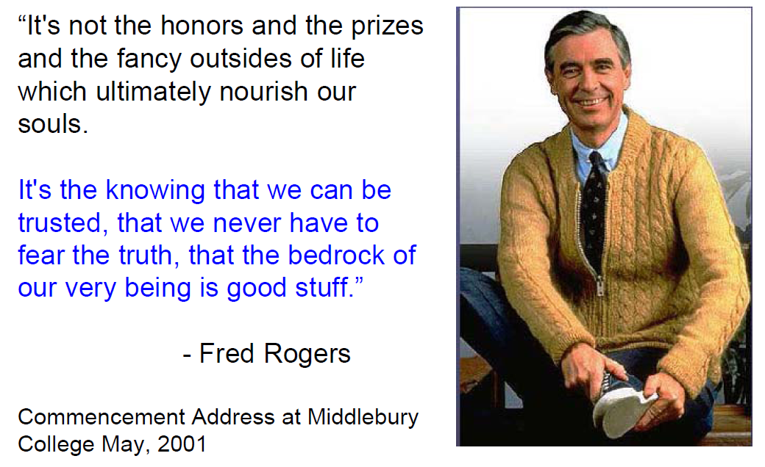

Slide 21
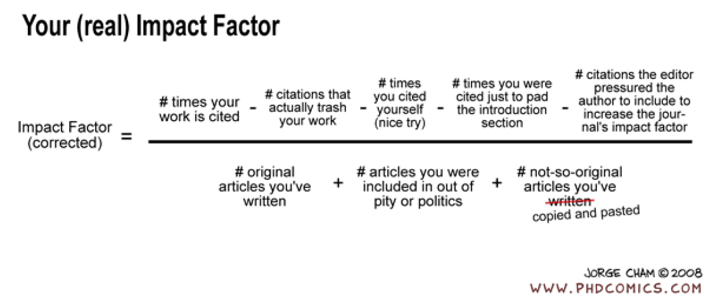

Slide 22
Which of the following best describes the "impact factor" of a scientific journal?
A) The number of articles published per year
B) The number of citations received by a journal's articles over a specific period
C) The cost of publishing in the journal
D) The number of authors affiliated with the journal
What is a key factor that enhances the impact of a scientific paper?
A) Length of the paper
B) Quality and originality of the research
C) Number of authors
D) Use of complex jargon
Which section of a scientific paper typically outlines the significance and potential impact of the research findings?
A) Introduction
B) Methods
C) Results
D) Discussion
How does clear and concise writing affect the impact of a scientific paper?
A) It reduces the paper’s chances of being published
B) It makes the paper less accessible to a wider audience
C) It improves the readability and comprehension, thus increasing its impact
D) It limits the number of citations

Slide 23
What role do keywords play in increasing the impact of a scientific article?
A) They enhance the paper’s aesthetic appeal
B) They help improve the paper’s visibility in search engines and databases
C) They determine the paper’s length
D) They provide financial support for the research
Which of the following is an effective strategy to increase the reach and impact of a scientific paper?
A) Restricting access to the paper to select individuals
B) Presenting findings at conferences and seminars
C) Using overly technical language
D) Limiting the paper to a specific niche audience
Why is it important to address limitations and future directions in a scientific paper?
A) To increase the length of the paper
B) To acknowledge the research's shortcomings and suggest areas for further study, which can enhance impact
C) To avoid criticism from reviewers
D) To ensure the paper gets published in high-impact journals
What is the primary purpose of a well-written abstract in a scientific paper?
A) To summarize the methods used in the study
B) To provide a brief and compelling overview of the study’s purpose, methods, results, and impact
C) To list all references cited in the paper
D) To describe the author’s background

Slide 24
Which of the following can help a researcher measure the impact of their own work?
A) Tracking the number of co-authors
B) Monitoring citations and altmetrics (e.g., social media mentions)
C) Counting the number of journals where the paper is submitted
D) Calculating the total word count of the paper
How does publishing in open-access journals affect the impact of scientific research?
A) It generally decreases impact due to restricted access
B) It increases impact by making the research accessible to a broader audience
C) It has no effect on the impact of research
D) It limits the research's exposure to academic audiences
What is the effect of a high citation count on a scientific paper's impact?
A) It has no effect
B) It decreases the perceived quality of the research
C) It generally increases the paper’s perceived importance and impact
D) It limits the paper’s chances of being read
Which aspect of scientific writing helps in demonstrating the relevance and potential applications of research findings?
A) The literature review
B) The research methodology
C) The discussion section
D) The acknowledgments section

Slide 25
What is the role of clear visuals (e.g., graphs, charts) in scientific papers?
A) To increase the word count
B) To provide aesthetic appeal
C) To effectively communicate complex data and enhance the impact of the findings
D) To replace detailed statistical analysis
How does engaging with the scientific community through networking and collaborations affect research impact?
A) It has no effect
B) It can increase the visibility and influence of the research
C) It restricts the research’s reach
D) It delays the publication process
What is the impact of choosing a high-impact journal for publication?
A) It decreases the likelihood of the paper being read
B) It potentially increases the visibility and credibility of the research
C) It has no effect on the paper’s impact
D) It guarantees high citation rates

Slide 26
